Slide 1
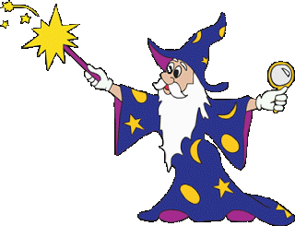
War Must Be
SPELL CARDS

Slide 2
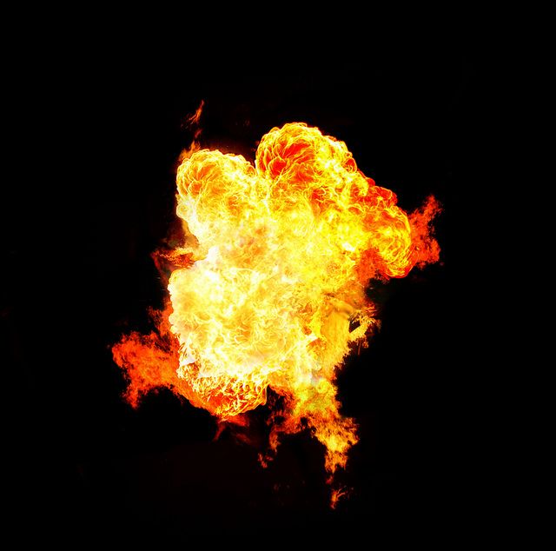


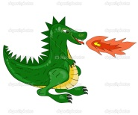




Fireball – 2 AC
 | Spell Level
Wizard Level | 0" to 5" | >5" to 10" | >10" to 15" | >15"
1 | 1.5 | 1 | 0.25 | 0
2 | 2 | 1.25 | 0.5 | 0
3 | 2.5 | 1.5 | 0.75 | 0
4 | 3 | 2 | 1 | 0
Basic Attack Value Versus: |  |  | Increase/Decrease Modifiers to Attack Value:
Units | IND | Wizard
8 | 10 | 10 | 2 x Basic Attack Value | ½ x Basic Attack Value | No Increase or Decrease | 1½ x Basic Attack Value | ½ x Basic Attack Value
Cold Beings & Ents
Hot Beings
Heavy Armor
The Undead
In Protective Cover
MPK = (SPELL LEVEL x BASIC ATTACK VALUE x MODIFIER %) x AVERAGING DIE

Slide 3

Cold Spell – 2 AC
 | Spell Level
WizardLevel | 0" to 5" | >5" to 10" | >10" to 15" | >15"
1 | 1.5 | 1 | 0.25 | 0
2 | 2 | 1.25 | 0.5 | 0
3 | 2.5 | 1.5 | 0.75 | 0
4 | 3 | 2 | 1 | 0
Basic Attack Value Versus: |  |  | Increase/Decrease Modifiers to Attack Value:
Units | IND | Wizard
8 | 12 | 10 | ½ x Basic Attack Value | 2 x Basic Attack Value | No Increase or Decrease | 1½ x Basic Attack Value | ½ x Basic Attack Value
Cold Beings & Ents
Hot Beings
Heavy Armor
The Undead
In Protective Cover
MPK = (SPELL LEVEL x BASIC ATTACK VALUE x MODIFIER %) x AVERAGING DIE

Slide 4

Lightning Bolt – 2 AC
 | Spell Level
Wizard Level | 0" to 5" | >5" to 10" | >10" to 15" | >15"
1 | 1.5 | 1 | 0.25 | 0
2 | 2 | 1.25 | 0.5 | 0
3 | 2.5 | 1.5 | 0.75 | 0
4 | 3 | 2 | 1 | 0
Basic Attack Value Versus: |  |  | Increase/Decrease Modifiers to Attack Value:
Units | IND | Wizard
8 | 12 | 10 | No Increase or Decrease | No Increase or Decrease | 2 x Basic Attack Value | 1½ x Basic Attack Value | ½ x Basic Attack Value
Cold Beings & Ents
Hot Beings
Heavy Armor
The Undead
In Protective Cover
MPK = (SPELL LEVEL x BASIC ATTACK VALUE x MODIFIER %) x AVERAGING DIE

Slide 5

Mega-Blast – 3 AC
 | Spell Level
Wizard Level | 0" to 5" | >5" to 10" | >10" to 15" | >15"
1 | 1.5 | 1 | 0.25 | 0
2 | 2 | 1.25 | 0.5 | 0
3 | 2.5 | 1.5 | 0.75 | 0
4 | 3 | 2 | 1 | 0
Basic Attack Value Versus: |  |  | Increase/Decrease Modifiers to Attack Value:
Units | IND | Wizard
10 | 14 | 10 | No Increase or Decrease | No Increase or Decrease | No Increase or Decrease | 2½ x Basic Attack Value | ½ x Basic Attack Value
Cold Beings & Ents
Hot Beings
Heavy Armor
The Undead
In Protective Cover
MPK = (SPELL LEVEL x BASIC ATTACK VALUE x MODIFIER %) x AVERAGING DIE

Slide 6

Nullify – 1 to 4 AC
AC Cost | Range | Effect | Duration of Effect | Nullified or Partially Nullified by? | No Effect on?
1-4 AC | 0-8" | Nullifies or Reduces The effects of Some Spells | Variable | Cannot be Nullified | Certain Spells
Nullify (1-4 AC) reduces the MPK an incoming Attack Spell by 50%/2 AC used or limit a General Spell by the same # of AC – as a Nullify depends on the # of AC its caster uses to throw it, and the type of incoming spell. A 3 AC Nullify can disperse a swarm. The Wizard must announce the # of AC used and play this Spell Card before the Attack Spell is rolled for or the General Spell takes effect. Nullify cannot be used on Fly, His Master’s Voice, Wild Pitch, Suck It Up Sunshine, Don’t Worry, Be Happy, or another Nullify.

Slide 7

William Tell – 3 AC
AC Cost | Range | Effect | Duration of Effect | Nullified or Partially Nullified by? | No Effect on?
3 | 0-8" | Enhances Friendly Missile Fire | Instantaneous | Nullify or The Yips | N/A
William Tell improves missile capabilities. The affected unit must not be retreating/pinned, must have AC to fire, and may only fire as its next action. When used on a CSW unit or boulder-thrower, the entity will hit its target automatically the next time it fires. MPK is unaffected, but the hit is guaranteed in-range. It must be cast before dice are rolled, and no matter what happens to the averaging dice, there will be no misfire. After a William Tell is cast, the CSW/boulder thrower can subtract 2 from the deflection and elevation dice in addition to other modifiers if the same target is engaged again from the same position. For any other type of missile unit, a William Tell doubles the final MPK as long as the target is in range.

Slide 8

Wild Pitch– 3 AC
AC Cost | Range | Effect | Duration of Effect | Nullified or Partially Nullified by? | No Effect on?
3 | 0-8" | Diverts a Large Missile Attack | Instantaneous | N/A | N/A
Wild Pitch is cast on an incoming large missile attack. The caster must cast this after the averaging die is rolled for a misfire. The caster uses the Spell Card and the AC, then rolls D6’s sequentially one at a time. The first die indicates deflection (1, 2, or 3 = target’s right and 4, 5, or 6 = target’s left). The caster then rolls 2 D6 for the degree of deflection away from the target (2-12 inches). The third roll of the D6 indicates elevation (1, 2, or 3 = long & 4, 5, 6 = short of the target). The caster then rolls 2 D6 to determine the degree of elevation difference away from the target (2-12 inches). Wherever the large missile hits, resolve the hit as any CSW attack.

Slide 9
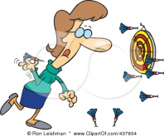
The Yips– 3 AC
AC Cost | Range | Effect | Duration of Effect | Nullified or Partially Nullified by? | No Effect on?
3 | 0-8" | Reduces Enemy Missile Effectiveness | 1D4 Activations | Nullify or William Tell | N/A
The Yips is cast on an enemy non-crew-served missile entity with missile capability. The Yips reduces MPK by 50% by the unit for 1D4 activations. For a Nullify to counter The Yips, it must also be cast on the firing unit. The casting of a William Tell nullifies The Yips (and vice-versa) on missile entities with small missile weapons (bows, slings, pistols).

Slide 10

Charles Atlas – 3 AC
AC Cost | Range | Effect | Duration of Effect | Nullified or Partially Nullified by? | No Effect on?
3 | 0-8" | Enhances Friendly Melee Attack Effectiveness | 1D4 Activations | Nullify or 98-lb Weakling | N/A
A Charles Atlas can be cast on any friendly unit in melee. The caster uses the Spell Card, and the 3 AC. The target/affected unit must be within 8”. A Charles Atlas increases melee MPK by 50% by the unit for 1D4 activations. For a Nullify to counter a Charles Atlas, it must be cast on the unit. The casting of a 98-lb Weakling nullifies a Charles Atlas (and vice-versa).

Slide 11

98-lb Weakling – 3 AC
AC Cost | Range | Effect | Duration of Effect | Nullified or Partially Nullified by? | No Effect on?
3 | 0-8" | Reduces Enemy Melee Attack Effectiveness | 1D4 Activations | Nullify or Charles Atlas | N/A
A 98-lb Weakling can be cast on any enemy unit in melee. The caster uses the Spell Card, and the 3 AC. A 98-lb Weakling decreases melee MPK by 50% by the enemy unit for 1D4 activations. For a Nullify to counter a 98-lb Weakling, it must be cast on the unit. The casting of a Charles Atlas nullifies a 98-lb Weakling (and vice-versa).

Slide 12

Thorny Devil – 1 to 2 AC
AC Cost | Range | Effect | Duration of Effect | Nullified or Partially Nullified by? | No Effect on?
1-2 AC | 0-8" | Creates an Entanglement | 1D4 Activations | Nullify | N/A
This creates a circular obstacle or entanglement on land 5" in diameter per AC used to cast it. The caster uses the Spell Card, and the 1-2 AC. Any movement through or out of the entanglement is at half rate. Combat is generally unaffected, although no charges may occur into or out of an entanglement. For a Nullify to counter a Thorny Devil, it must be cast on the obstacle.

Slide 13
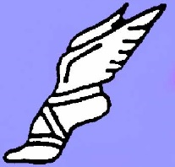
Alacrity – 3 AC
AC Cost | Range | Effect | Duration of Effect | Nullified or Partially Nullified by? | No Effect on?
3 AC | 0-8" | 2 x Unit Movement Rate | 1D4 Activations | Nullify or LSD | The Undead
An Alacrity spell can be cast on any friendly unit except The Undead. The caster uses the Spell Card, and the 3 AC. Alacrity doubles the movement rate of the unit upon which it is cast for 1D4 activations. Alacrity cannot be used on individuals. For a Nullify to counter an Alacrity, it must be cast on the unit. The casting of an LSD nullifies an Alacrity (and vice-versa).

Slide 14

LSD – 3 AC
AC Cost | Range | Effect | Duration of Effect | Nullified or Partially Nullified by? | No Effect on?
3 AC | 0-8" | Halves Unit Movement Rate | 1D4 Activations | Nullify or Alacrity | The Undead
An LSD spell can be cast on any enemy unit except The Undead. LSD halves the movement rate of the unit upon which it is cast for 1D4 activations. LSD cannot be used on individuals. For a Nullify to counter an LSD, it must be cast on the unit. The casting of an Alacrity nullifies an LSD (and vice-versa).

Slide 15
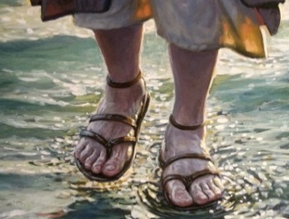
Walk on Water – 4 AC
AC Cost | Range | Effect | Duration of Effect | Nullified or Partially Nullified by? | No Effect on?
3 AC | 0-8" | Allows Movement on Water | 1D4 Activations | Nullify | The Undead
Can use on any friendly entity except The Undead. Enables passage over a body of water as if it were land for 1D4 activations. The water is treated as open land for movement and combat. A unit defending such a body of water gets no defensive benefit. If it wears off and the entity is still on the water, the entity is cast into the water and potentially drowned, depending on the conditions and the entity’s size of. For a Nullify to counter a Walk on Water, it must be cast on the unit. The degree of nullification depends on the # of AC used to cast the Nullify.

Slide 16

Wall of Smoke – 2 AC
AC Cost | Range | Effect | Duration of Effect | Nullified or Partially Nullified by? | No Effect on?
2 AC | 0-8" | Creates a Wall of Smoke | 1D4 Activations | Nullify | N/A
This creates a 3” high by 1” deep by 6” long smoke cloud for 1D4 activations. It can be cast anywhere within 8” with LOS/LOF restrictions. This cloud blocks LOS, and makes melee combat half as effective for both sides engaged (MPK is halved). Unit and individual movement must stop at a Wall of Smoke, and spend 2 AC to cross it on the next activation. Flyers may go over this wall at no cost, but hoverers must stop and spend the 2 AC to cross at the next activation. For a Nullify to counter a Wall of Smoke, it must be cast on the cloud.

Slide 17

Wall of Flame – 2 AC
AC Cost | Range | Effect | Duration of Effect | Nullified or Partially Nullified by? | No Effect on?
2 AC | 0-8" | Creates a Wall of Flame | 1D4 Activations | Nullify | N/A
This creates a 3” high by 1” deep by 6” long wall of flame for 1D4 activations. It can be cast anywhere within 8” with LOS/LOF restrictions. This wall blocks LOS, and makes melee combat impossible as it cannot be crossed while it is there. It may be overflown by flyers. Unit and individual movement must stop 1” from a Wall of Flame. Flyers may go over this wall at no cost, but hoverers may not. Any unit caught in the middle of a Wall of Flame takes a hit just as if it were a Fireball. For a Nullify to counter a Wall of Flame, it must be cast on it.

Slide 18

Suck It Up Sunshine – 3 AC
AC Cost | Range | Effect | Duration of Effect | Nullified or Partially Nullified by? | No Effect on?
3 AC | 0-4" | Removes Current Fatigue, unpins/stops retreat | Instantaneous | N/A | The Undead
This can be cast on an entity within 4” and allows the removal of all current fatigue points and unpins and/or stops the retreat of an entity. The unit’s activation die is changed from black or red to its regular color, and it immediately is available for activation in line/column/mass/open formation, depending on the capabilities of the unit. Nullify has no counter effect.

Slide 19

I ain’t a-skeered o’ Ya – 4 AC
AC Cost | Range | Effect | Duration of Effect | Nullified or Partially Nullified by? | No Effect on?
4 AC | 0-4" | Removes Any Possibility of Fear from Undead, Monster, or Magic Attacks | Entire Game unless nullified | 4 AC Nullify | Elves, The Undead
This spell can be cast on a living entity to prevent the negative effects of fear on Morale checks caused by magic, monster, or attacks by The Undead. This spell’s duration is for the length of the game – unless a 4 AC Nullify is used to nullify it.

Slide 20
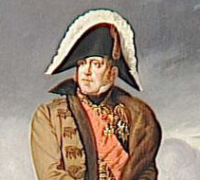
Marshal Ney – 3 AC
AC Cost | Range | Effect | Duration of Effect | Nullified or Partially Nullified by? | No Effect on?
3 AC | 0-4" | Nullifies a Unit Morale Break and No Morale Checks for 1D4 Activations | 1D4 Activations | Nullify or Overlook Hotel | The Undead
This can bolster Morale, even if the unit has just failed a Morale Check. The target of a Marshal Ney will not need a Morale Check for 1D4 activations regardless of casualties or any other factor. A Marshal Ney will nullify a unit Morale break as long as the spell was cast immediately.

Slide 21
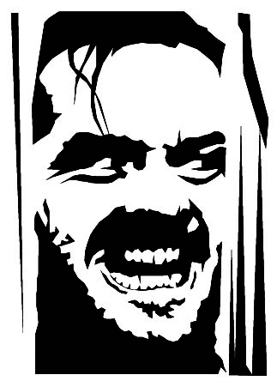
Overlook Hotel – 3 AC
AC Cost | Range | Effect | Duration of Effect | Nullified or Partially Nullified by? | No Effect on?
3 AC | 0-4" | Degrades Morale - Must Roll 2x for Morale for 1D4 Activations + 20% | 1D4 Activations | Nullify or Marshal Ney | The Undead
This spell can be cast on a living entity to degrade Morale, even if it has just passed a Morale Check. A target of an Overlook Hotel must roll twice for a Morale Check for 1D4 activations regardless of casualties or any other factor, and add 20% to the chance to break.

Slide 22

Don’t Worry, Be Happy – 4 AC
AC Cost | Range | Effect | Duration of Effect | Nullified or Partially Nullified by? | No Effect on?
4 AC | 0-4" | Removes All Current Fatigue, and Resets Casualty Rate to Zero Losses for Morale Purposes | Instantaneous | N/A | The Undead
A truly awesome spell that can be cast on any living unit. The effect is twofold. First, it resets the current casualty rate of a unit to zero for Morale purposes. As an example, if a unit had 50% casualties – such as 6 figures out of 12 – a Don’t Worry Be Happy spell would make the unit feel as if it had not suffered any casualties at all for Morale purposes. In effect, it would be considered a 6 figure unit going forward for Morale. The second effect would be to remove all fatigue points from the unit. Nullify cannot be used against Don’t Worry Be Happy.

Slide 23
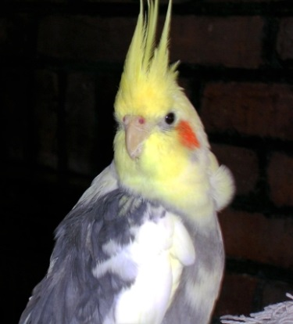
Fly – 1–4 AC
This is a Mundane Spell Card for reference only – no Spell Card is used up with casting of Fly.
AC Cost | Range | Effect | Duration of Effect | Nullified or Partially Nullified by? | No Effect on?
1 AC/10” of Flight | N/A | Wizard Flight (10“/AC) | Instantaneous | N/A | N/A
Wizards may use 1 AC when activated to fly up to 10” per AC. To attack ground units in any way while in flight, wizards must have an AC "in reserve“ that will remain unused at the activation's end after all movement is conducted or spells are cast. Otherwise, they must land (and can charge into combat). Once a Wizard lands, it is open to attack prior to conduct of offensive attacks or spell casting. Wizards may be attacked in flight by other flying creatures or by missile weapons.

Slide 24

His Master’s Voice – 2 AC
This is a Mundane Spell Card for reference only – no Spell Card is used up with casting of His Master’s Voice.
AC Cost | Range | Effect | Duration of Effect | Nullified or Partially Nullified by? | No Effect on?
2 AC per activation controlled | 0 – 6” | Control Beasts, Large Creatures, Large Animals, or Individual Creatures | 2 AC per activation controlled | Death of Wizard or Cessation of Spell | Trained or Semi-Sentient Animals
Wizards use 2 AC at the beginning of the activation, & give these extra AC to those controlled, who follow the Wizard’s wishes. Controlled creatures in groups fight as peasants; individuals fight as their level. If the Wizard ceases to exert control, the animals will either flee the battlefield (50% chance) or turn and fight the nearest entity to the death, including the Wizard (50% chance)! Any Wizard may reassert control with another His Master’s Voice. Controlled creatures do not move beyond 6” from the Wizard. If the Wizard dies, or flies more than 6” away from the controlled animals for any reason, control is broken.

Slide 25

Buzz – 3 AC
AC Cost | Range | Effect | Duration of Effect | Nullified or Partially Nullified by? | No Effect on?
3 AC (once per game) | 0 – 6” | Control a Swarm, Reduce Enemy Effectiveness | 1D4 Activations | Death of Wizard or Cessation of Spell | The Undead, Ents, Lizard men
This is the only Mundane Spell that is consumed. Wizards may control swarms by using this card & 3 AC. Swarms are clouds of stinging insects, but could also be groups of larger animals (rats, etc.). After creation, the swarm immediately forms and may move. Flying insect swarms are in the shape of a cloud, 3” high by 1” deep by 6” long. Ground swarms are in a similar size and shape, but do not extend vertically beyond the heads of those attacked. The swarm lasts for 1D4 activations, & can move up to 3” per turn, but may not move more than 6” from the controlling Wizard. Swarms don’t kill - they annoy and distract the enemy. Vulnerable forces attacked by controlled swarms find any MPK (missile or melee) reduced by 25%. Units vulnerable to and attacked by swarms also must add 10% to any Morale Break Roll they make while attacked by the swarm. Some units and individuals are invulnerable to Swarms. Among these would be The Undead, Ents, and Lizardmen of any type. If the Wizard dies or flies away, the swarm goes away. Swarms cannot be damaged. A 3 AC Nullify can disperse a swarm.

Slide 26
War Must Be
SPELL CARDS

